Slide 1
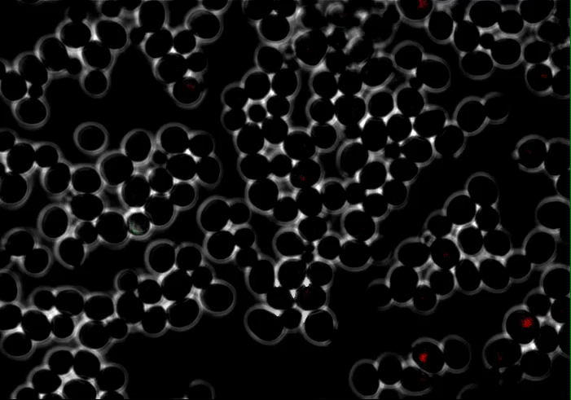
Big Data and Dynamic Cellular Response
Hossein Jashnsaz
Neuert lab
Molecular Physiology and Biophysics
Vanderbilt University
CANB8347
Tuesday, April 4, 2023

Slide 2
Outline
Tuesday, April 4, 2023
Big Biological Data
Dynamic Cellular Response
Thursday, April 6, 2023
Machine Learning and Model Parameter Inference
Jupyter notebook

Slide 3
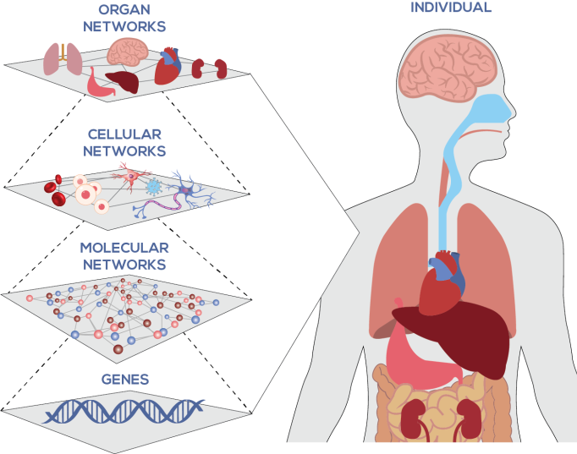
Human body: A network of interactions
Institute of Systems Biology
Notes:
Heart,
Injury
Immune cells
Signaling proteins

Slide 4
Big biological data
Biology is shifting toward being an informational science. The omics (genomics, proteomics, and metabolomics), in particular, are considered big data sciences.
Fluorescence Microscopy
Flow Cytometry
 | Gene 1 | Gene 2 | Gene 3 | Gene 4 | Gene 5 | … | Gene M
Cell 1 | values | values | values | values | values | … | values
Cell 2 | values | values | values | values | values | … | values
Cell 3 | values | values | values | values | values | … | values
Cell 4 | values | values | values | values | values | … | values
Cell 5 | values | values | values | values | values | … | values
… | … | … | … | … | … | … | …
Cell N | values | values | values | values | values | … | values
Multi-Dimensional Data Individuals
Gene
Time
Mutant
Sex
Race
Environment
Dug dose
Dall'Alba et al. A Survey of Biological Data in a Big Data Perspective. Big Data. 2022 279-297 http://doi.org/10.1089/big.2020.0383

Slide 5
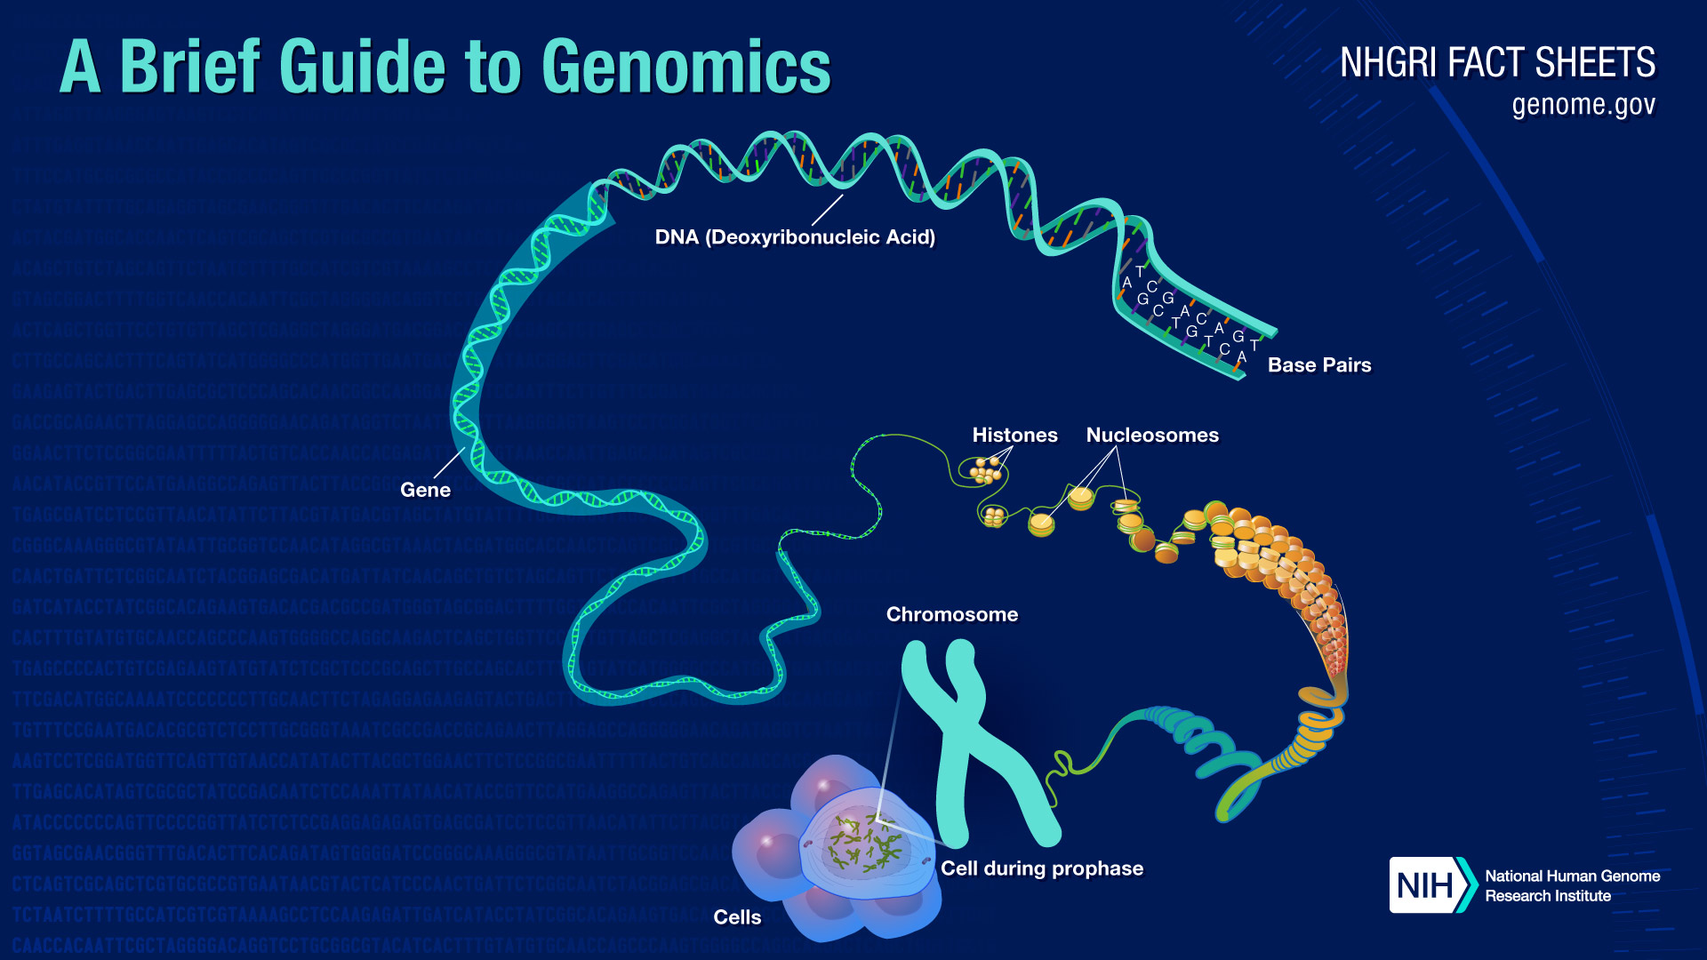
approximately 3 billion DNA base pairs
20,000 to 25,000 genes in the human genome
roughly 2 to 40 billion gigabytes of data now generated each year

Slide 6
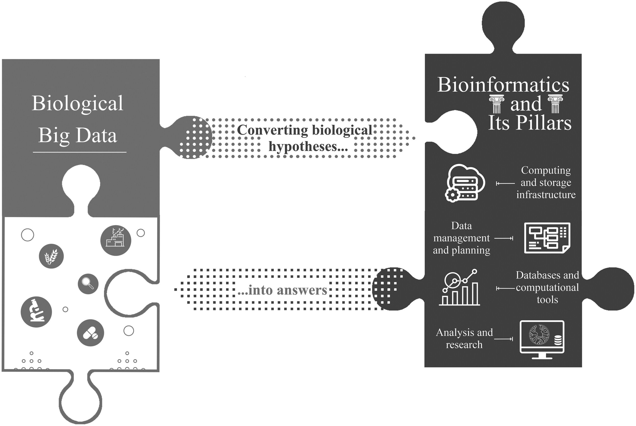
Integrating big data with bioinformatics and computational biology to generate knowledge.
Quantitative Biology
Big data
Data Science
Bioinformatics
Machine Learning
Computational biology
ACCRE
SLURM
Dall'Alba et al. A Survey of Biological Data in a Big Data Perspective. Big Data. 2022 279-297 http://doi.org/10.1089/big.2020.0383

Slide 7
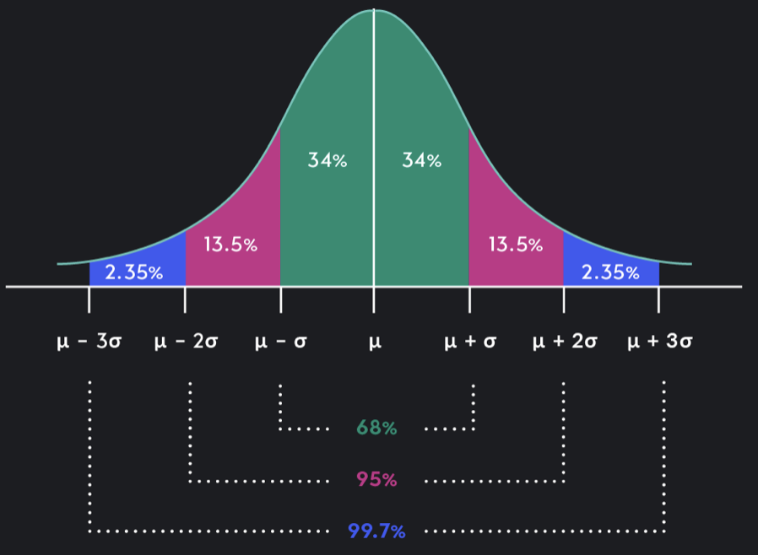
Working with Big Biological Data (Multi-Dimensional)
Types of Quantitative Data (e.g., continuous, discrete, categorical)
Normalization and dealing with Outliers (e.g., z-score)
Statistical Tests (e.g., K-S)
Sampling (e.g., multivariate normal, uniform)
Visualization (e.g., heatmap)
Clustering and Dimensionality Reduction (e.g., UMAP)
Fitting and Cross-Validation
Predictions
-3 -2 -1 0 1 2 3

Slide 8
Working with Big Biological Data (Multi-Dimensional)
Types of Quantitative Data (e.g., continuous, discrete, categorical)
Normalization and dealing with Outliers (e.g., z-score)
Statistical Tests (e.g., non-parametric K-S)
Sampling (e.g., multivariate normal, uniform)
Visualization (e.g., heatmap)
Clustering and Dimensionality Reduction (e.g., UMAP)
Fitting and Cross-Validation
Predictions
T-Test

Slide 9
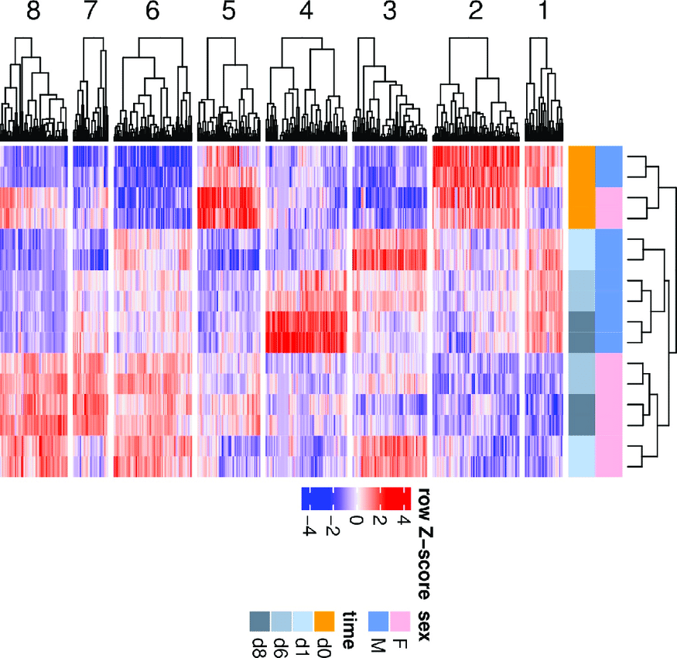
Working with Big Biological Data (Multi-Dimensional)
Types of Quantitative Data (e.g., continuous, discrete, categorical)
Normalization and dealing with Outliers (e.g., z-score)
Statistical Tests (e.g., non-parametric K-S)
Sampling (e.g., multivariate normal, uniform)
Visualization (e.g., heatmap)
Clustering and Dimensionality Reduction (e.g., UMAP)
Fitting and Cross-Validation
Predictions
EMBL’s European Bioinformatics Institute

Slide 10
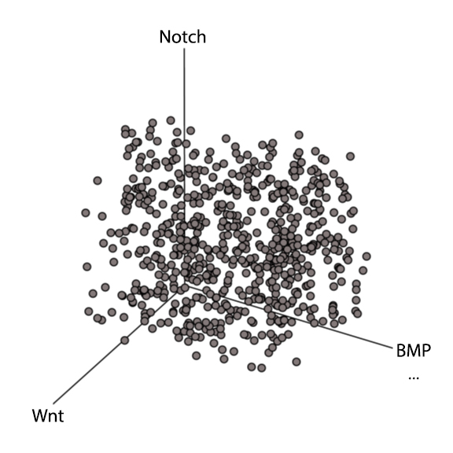
Working with Big Biological Data (Multi-Dimensional)
Types of Quantitative Data (e.g., continuous, discrete, categorical)
Normalization and dealing with Outliers (e.g., z-score)
Statistical Tests (e.g., non-parametric K-S)
Sampling (e.g., multivariate normal, uniform)
Visualization (e.g., heatmap)
Clustering and Dimensionality Reduction (e.g., UMAP)
Fitting and Cross-Validation
Predictions
Behavior 1
Behavior 2
Behavior 3
Behavior 4
Behavior 5
Behavior 6
Behavior 7

Slide 11
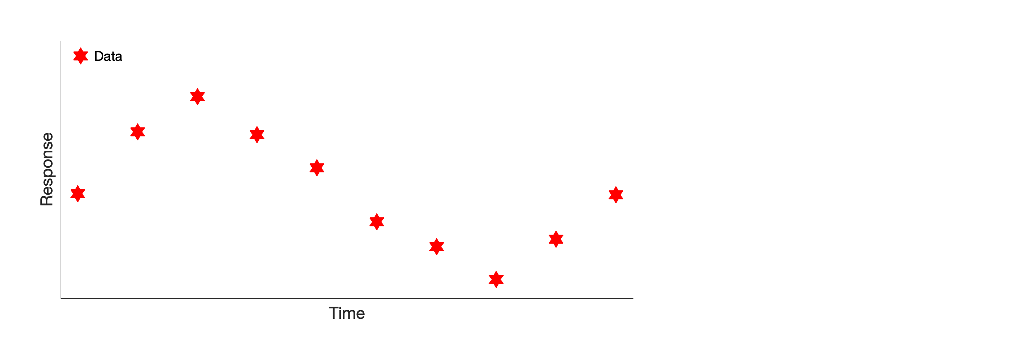
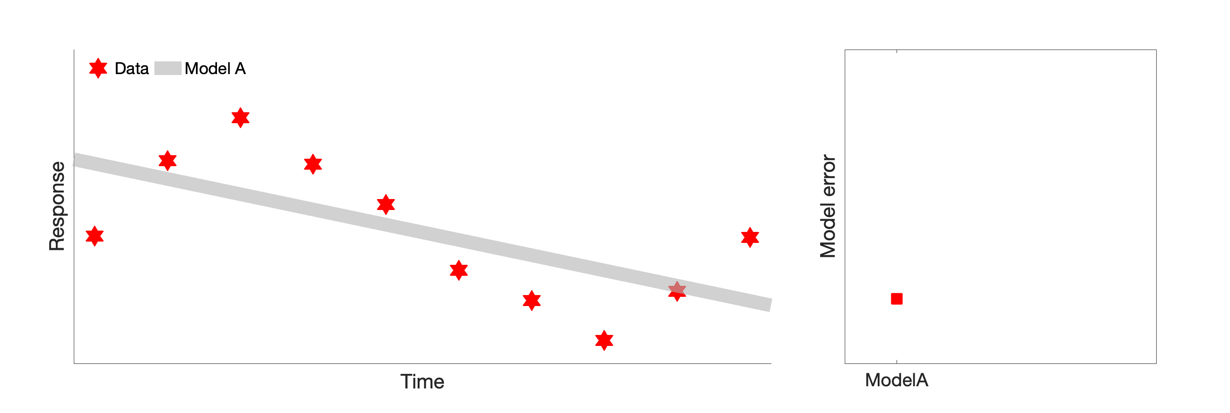
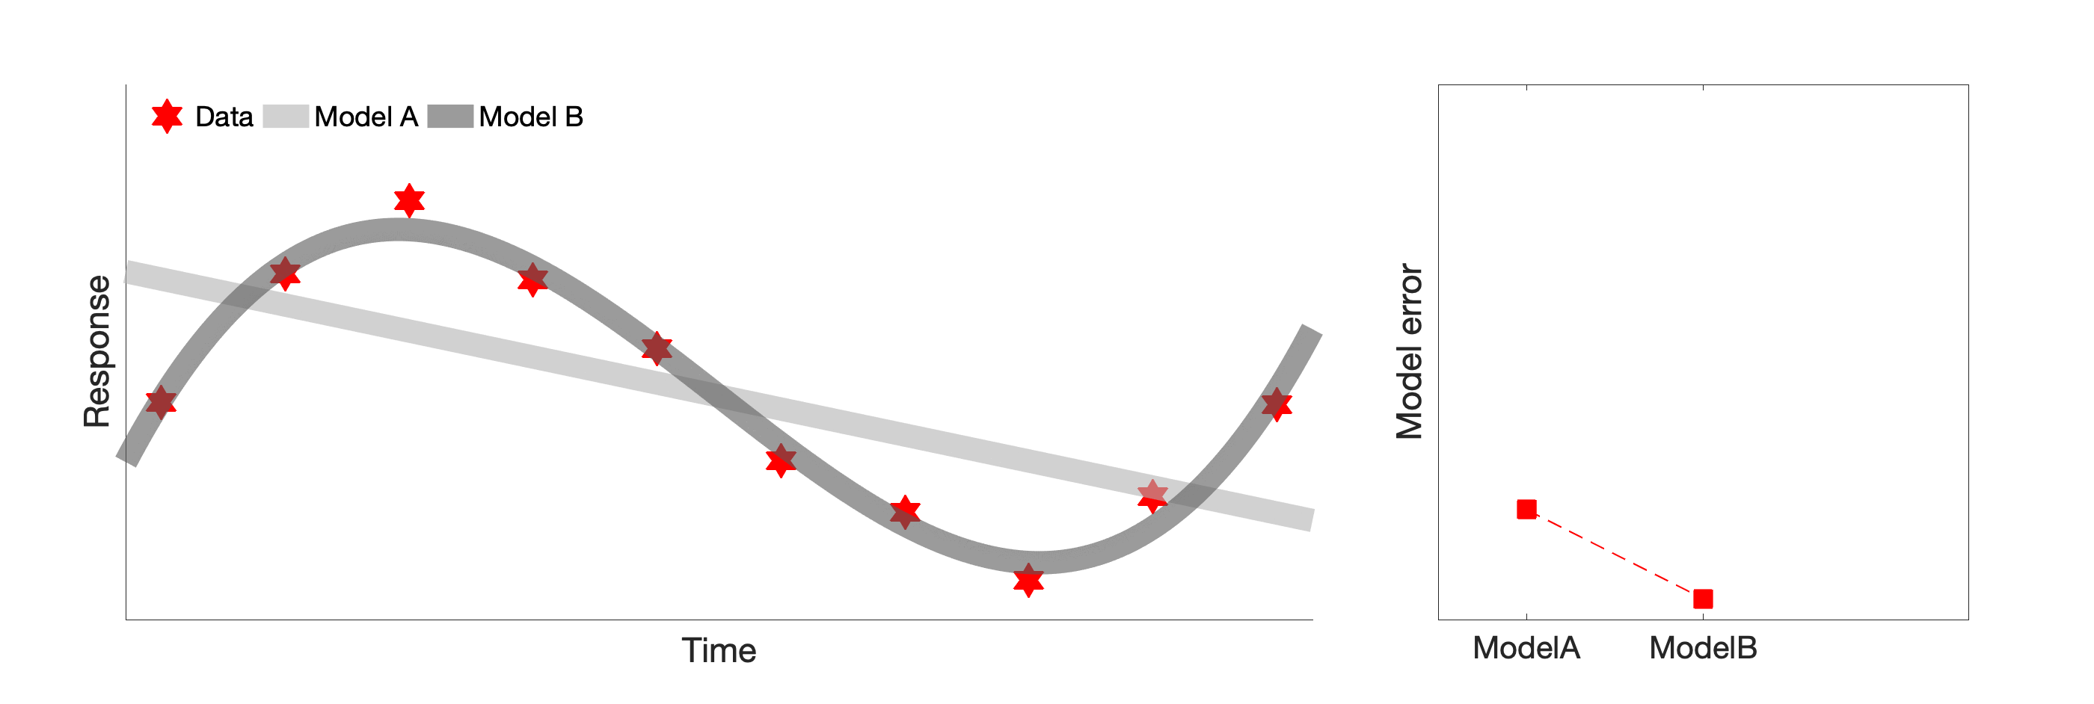
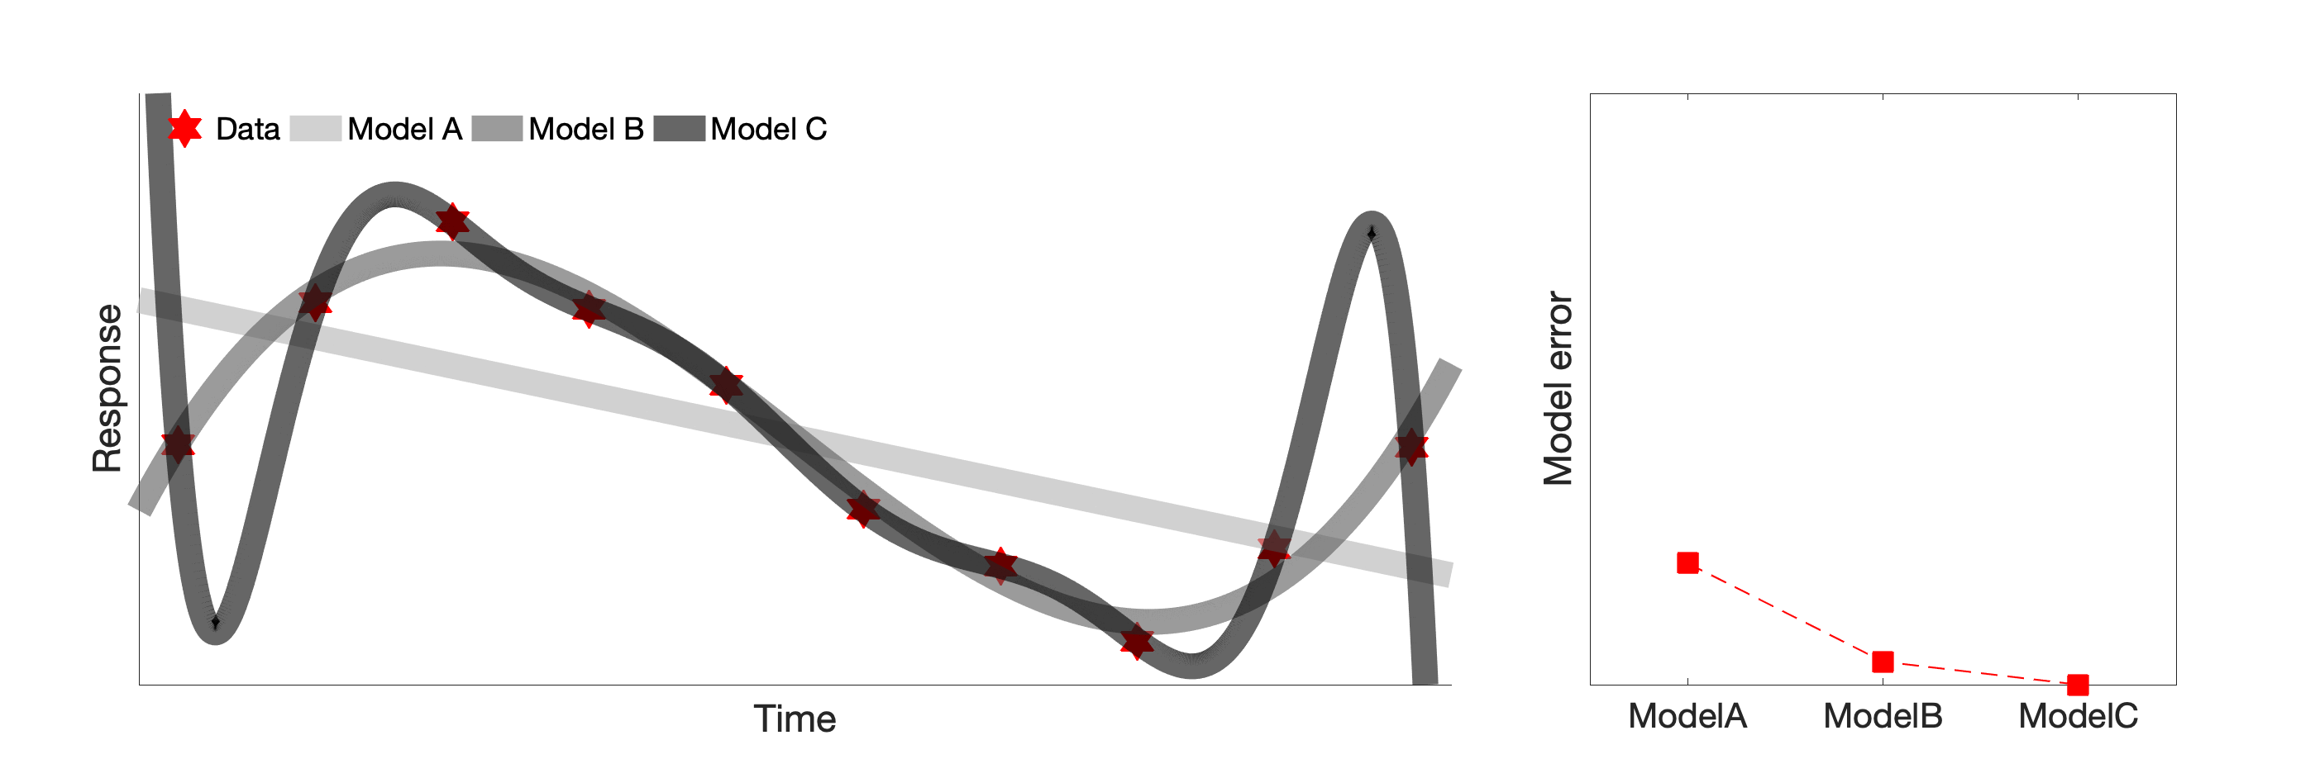
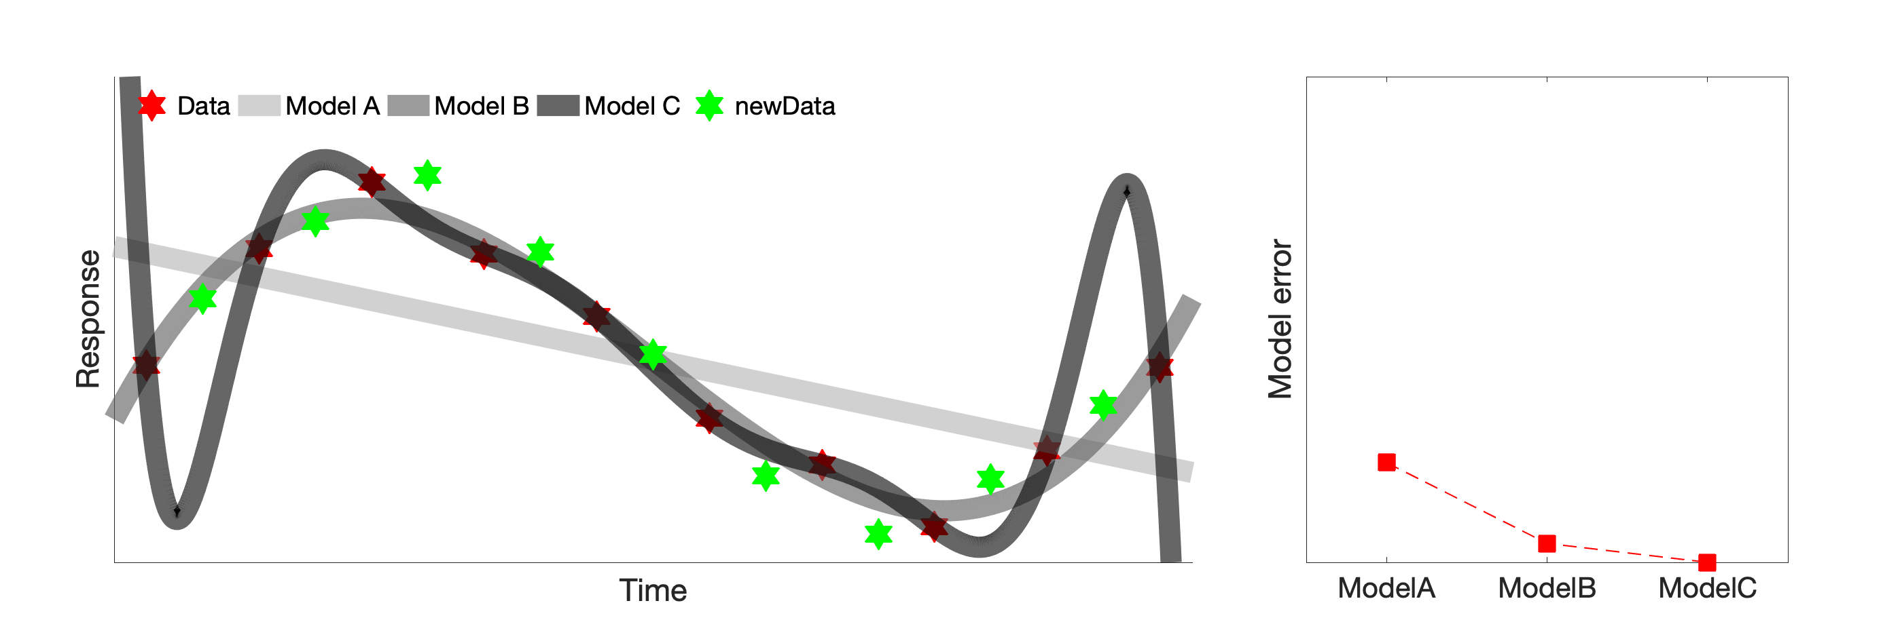
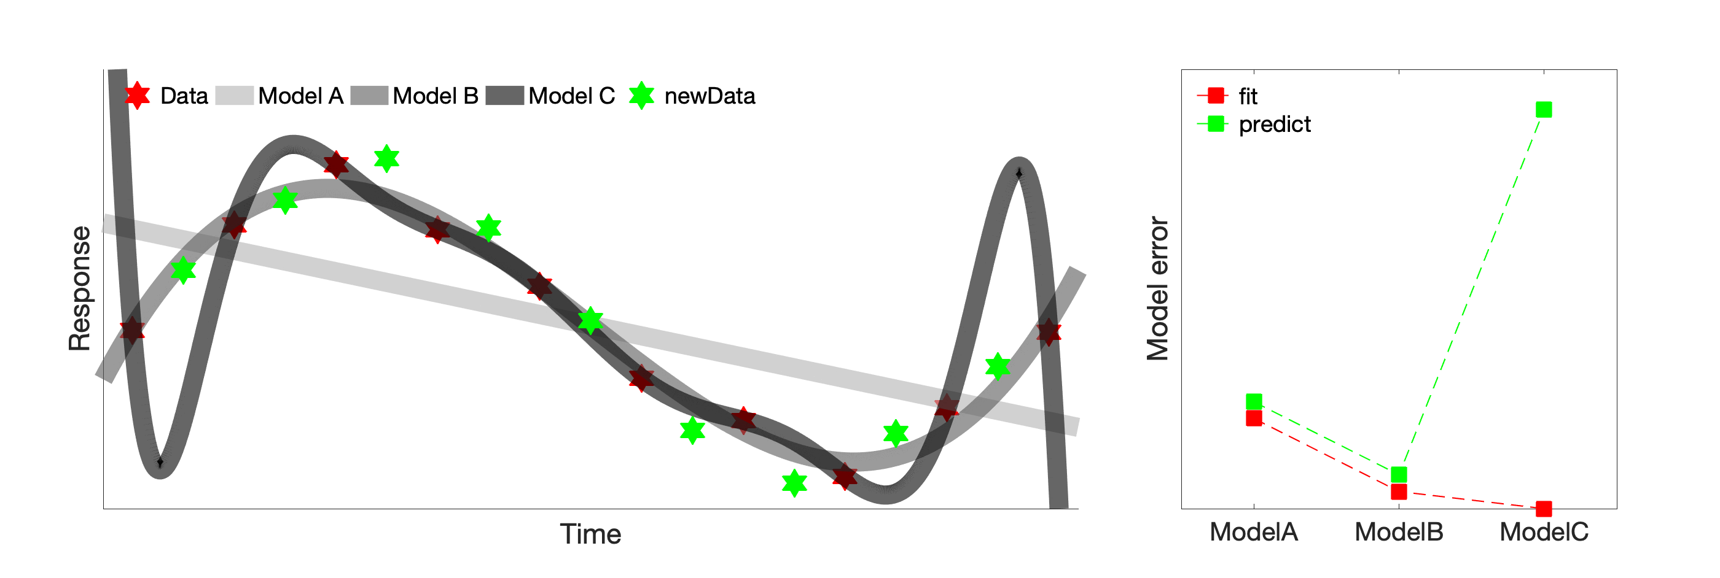
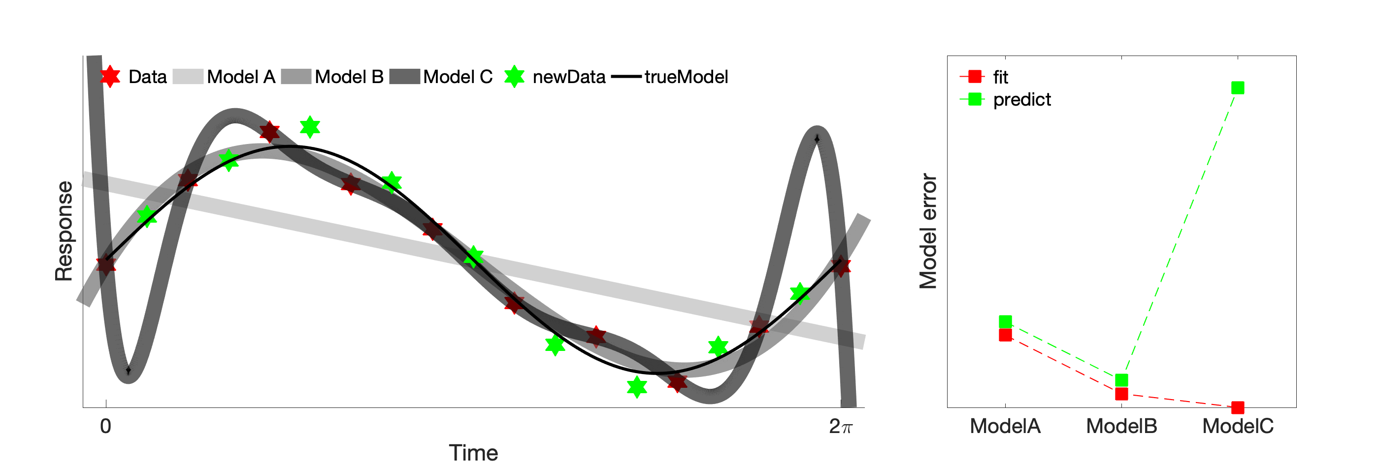

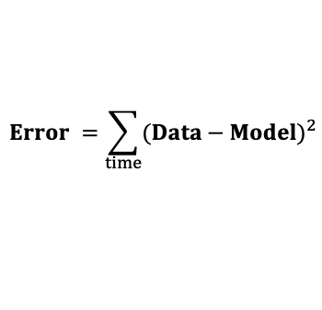
True model y(t) = sin(t) Model A y(t) = a+b*t Model B y(t) = a+b*t+c*t² +d*t³ Model C y(t) = a+b*t+c*t² +d*t³ + … + j*t⁹
Working with Big Biological Data (Multi-Dimensional)
$${Error}^{ }=\sum_{time}^{ }{{(Data−Model)}^{2}}$$
“All models are wrong, but some are useful” - the predictive ones.

Slide 12
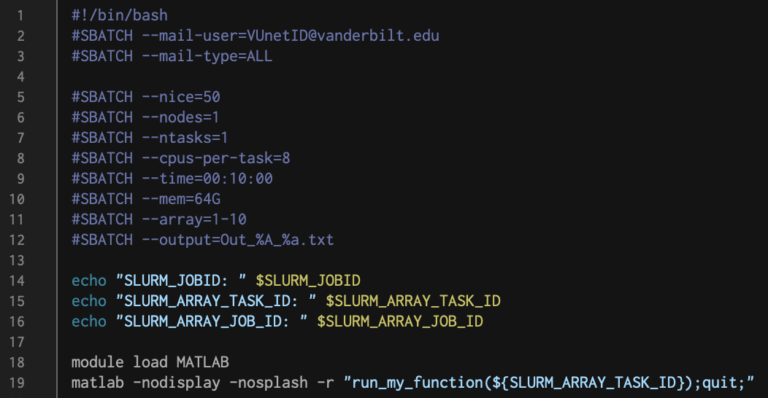
Working with Big Biological Data (Multi-Dimensional)
Types of Quantitative Data (e.g., continuous, discrete, categorical)
Normalization and dealing with Outliers (e.g., z-score)
Statistical Tests (e.g., non-parametric K-S)
Sampling (e.g., multivariate normal, uniform)
Visualization (e.g., heatmap)
Clustering and Dimensionality Reduction (e.g., UMAP)
Fitting and Cross-Validation
Predictions
Functions
def my_function(input1, input2, input3):
do something …
return [output1, output2]
mu, std = my_function(data,axis1,axis2)
ACCRE SLURM
run_my_function(job_ID)

Slide 13
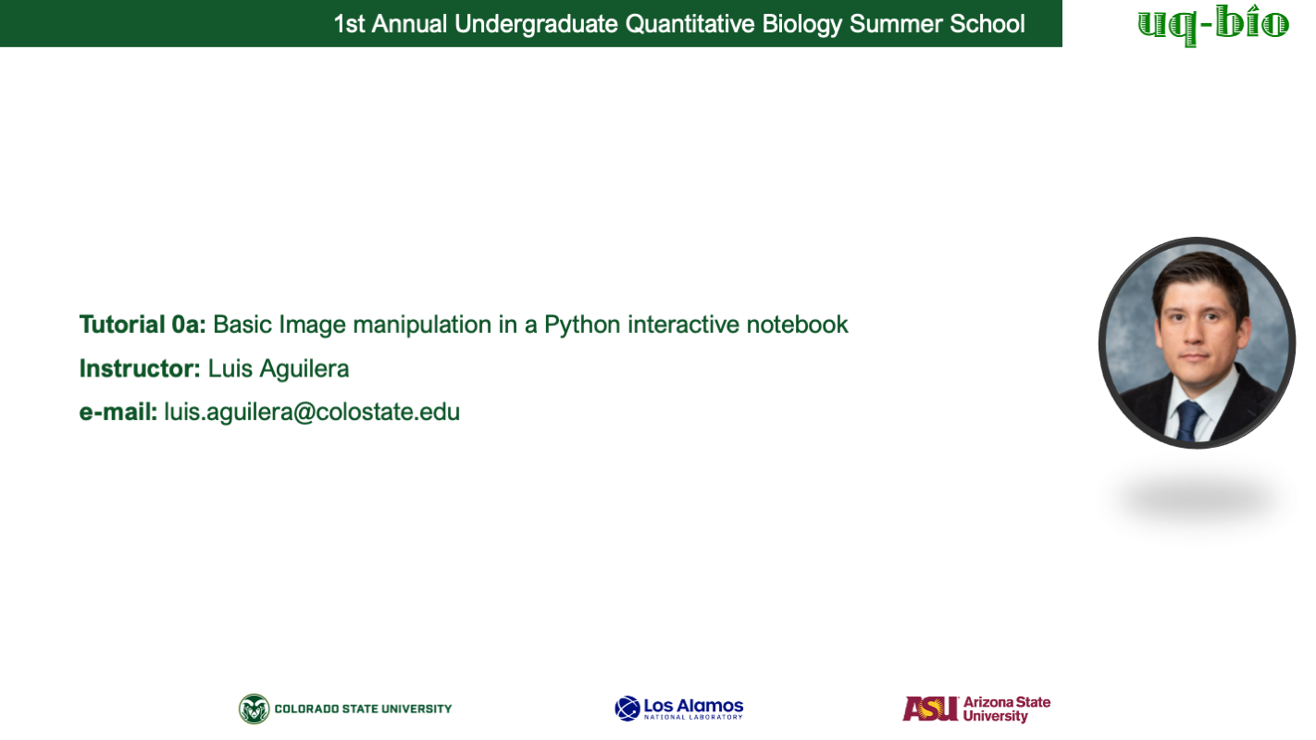
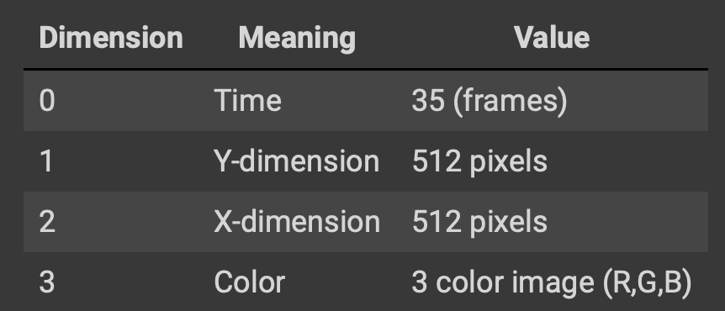
Working with Big Biological Data (Multi-Dimensional)
https://colab.research.google.com/drive/1o3JJE4EjfW9P5ZITEeS5p8Ui60xV3etK?usp=sharing#scrollTo=QPiYgZz3gSZG

Slide 14
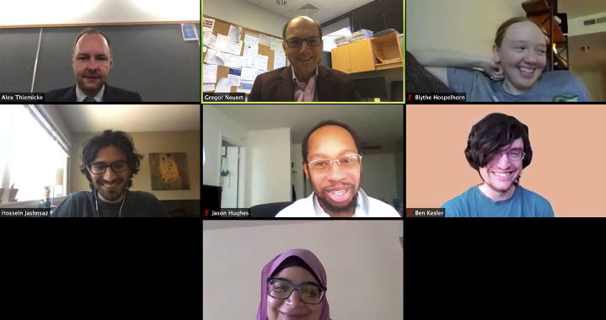
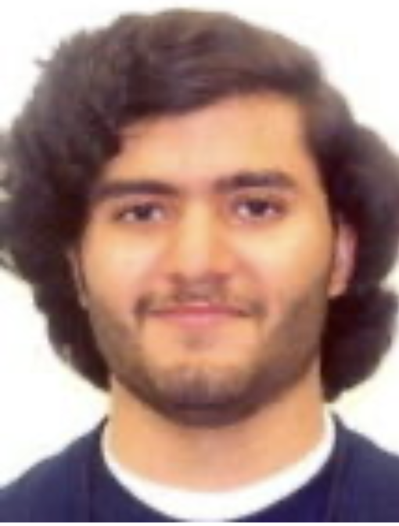

Acknowledgement
Collaborators:
Zachary R Fox, PhD
Los Alamos National Laboratory
Brian E Munsky, PhD
Colorado State University
Postdoctoral Committee:
Roger J Colbran, PhD
Owen P McGuinness, PhD
David G Harrison, MD
Ege T Kavalali, PhD
Todd R Graham, PhD
Vanderbilt University
Neuert Lab
John Adams
Abraheem Khouqeer
Blythe Hospelhorn
Jason Hughes
Ben Kesler
Gregor Neuert
Previous members
Rama Ali
Alex Thiemicke
Amanda Johnson
Rohit Venkat
Evan Wang
Guoliang Li
Advanced Computing Center for Research & Education
ACCRE Vanderbilt

Slide 15
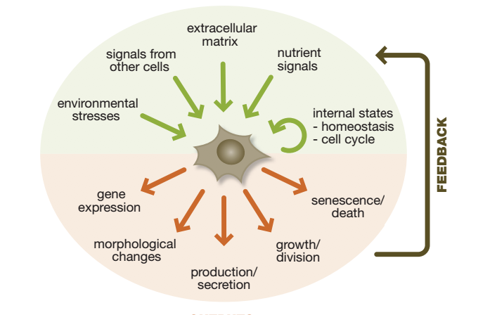
Cells experience changing stimuli.
STIMULI
FEEDBACK
FUNCTIONS
Adopted from Lim, Wendell; Mayer, Bruce; Pawson, Tony “Cell Signaling: principles and mechanisms”

Slide 16
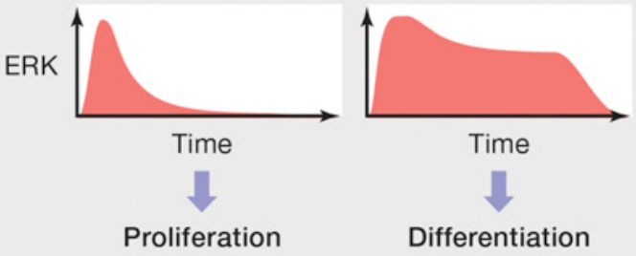
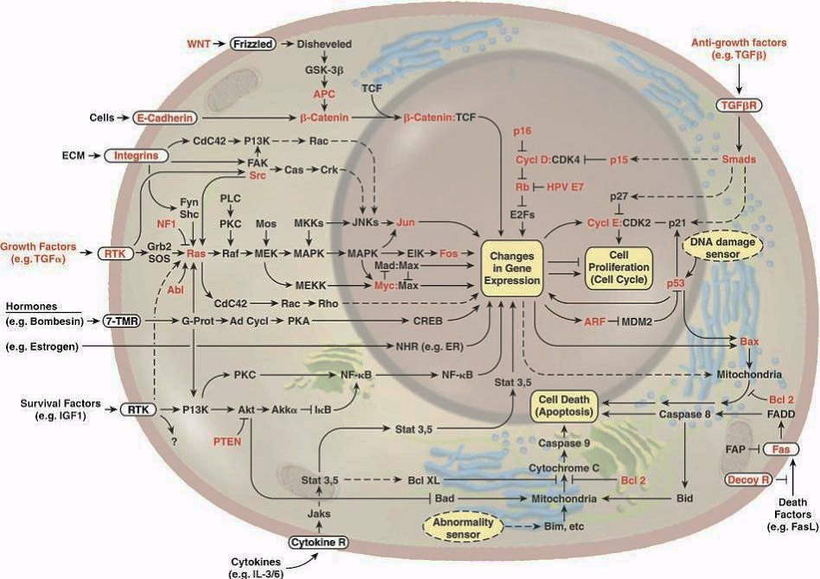
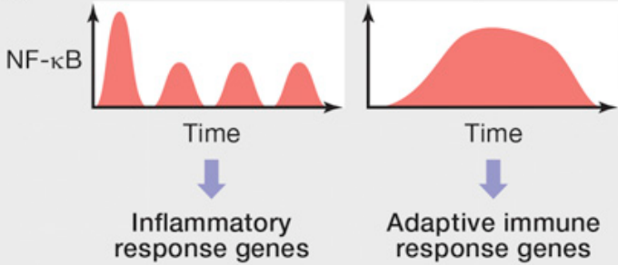
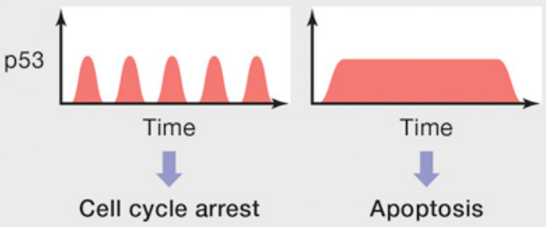
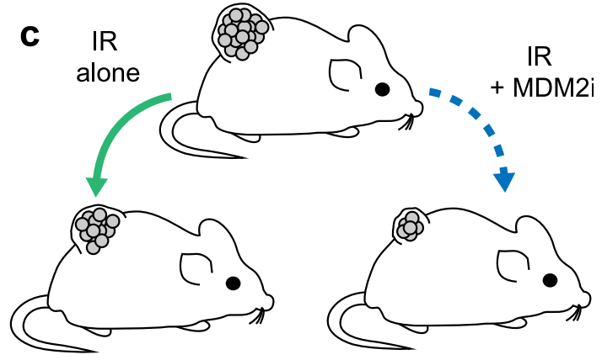
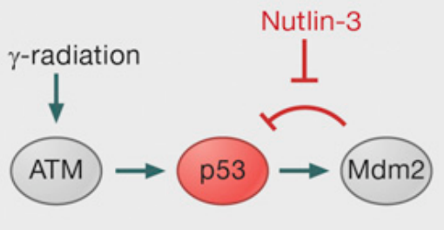
Signal transduction networks enable cellular response.
radiation
radiation
Hanahan and Weinberg, Cell, 2000
Purvis and Lahav, Cell, 2013
Stewart-Ornstein and Lahav, 2021

Slide 17
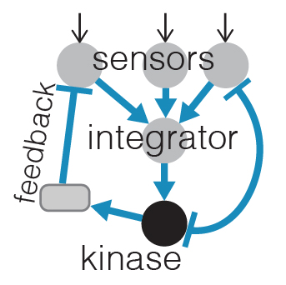
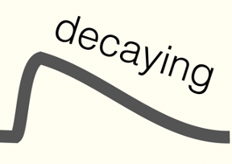
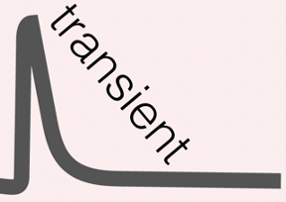
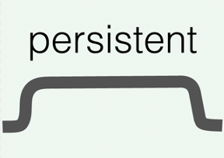
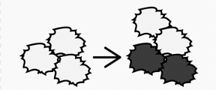
How does signaling dynamics and network topology contribute to cellular response?
NETWORK TOPOLOGY
SIGNALING DYNAMICS
PHENOTYPE

Slide 18
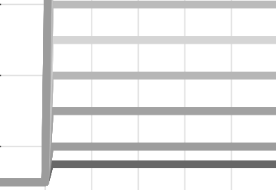
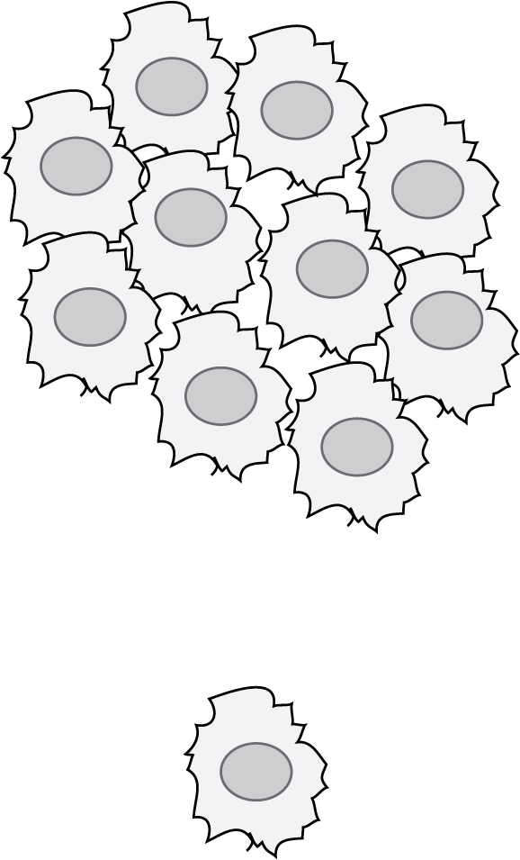
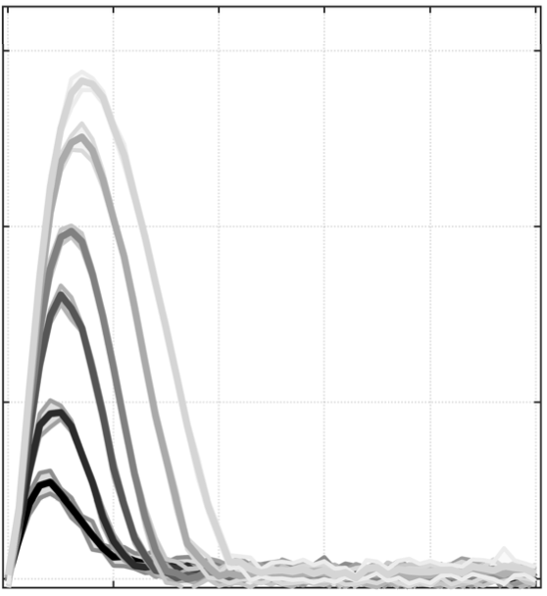
Predicting signaling dynamics remains challenging.
CHALLENGES
complexity
lack of in vivo rates
undiscovered feedbacks
heterogeneity
THE CURRENT PARADIGM
Hanahan, Weinberg, Cell, 2000

Slide 19
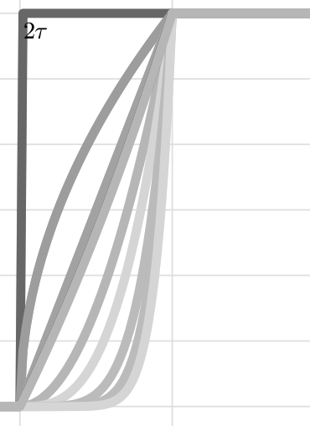
Temporal cell stimulation to better understand physiological signaling mechanisms.
Standard paradigm in cell biology
This project
step-like cell stimulations
time-varying cell stimulations
altered
response
Implement time-varying cell stimulation in experiments.
Thiemicke/Jashnsaz, 2019; Johnson, 2021; Jashnsaz, 2021
Temporal stimulations result in distinct cellular responses.
To build predictive models and to investigate signaling mechanisms.

Slide 20
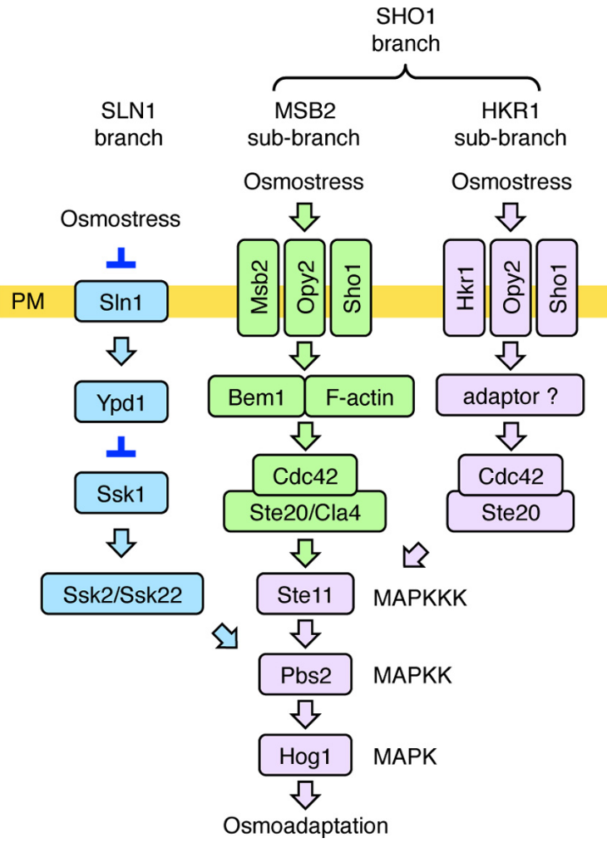
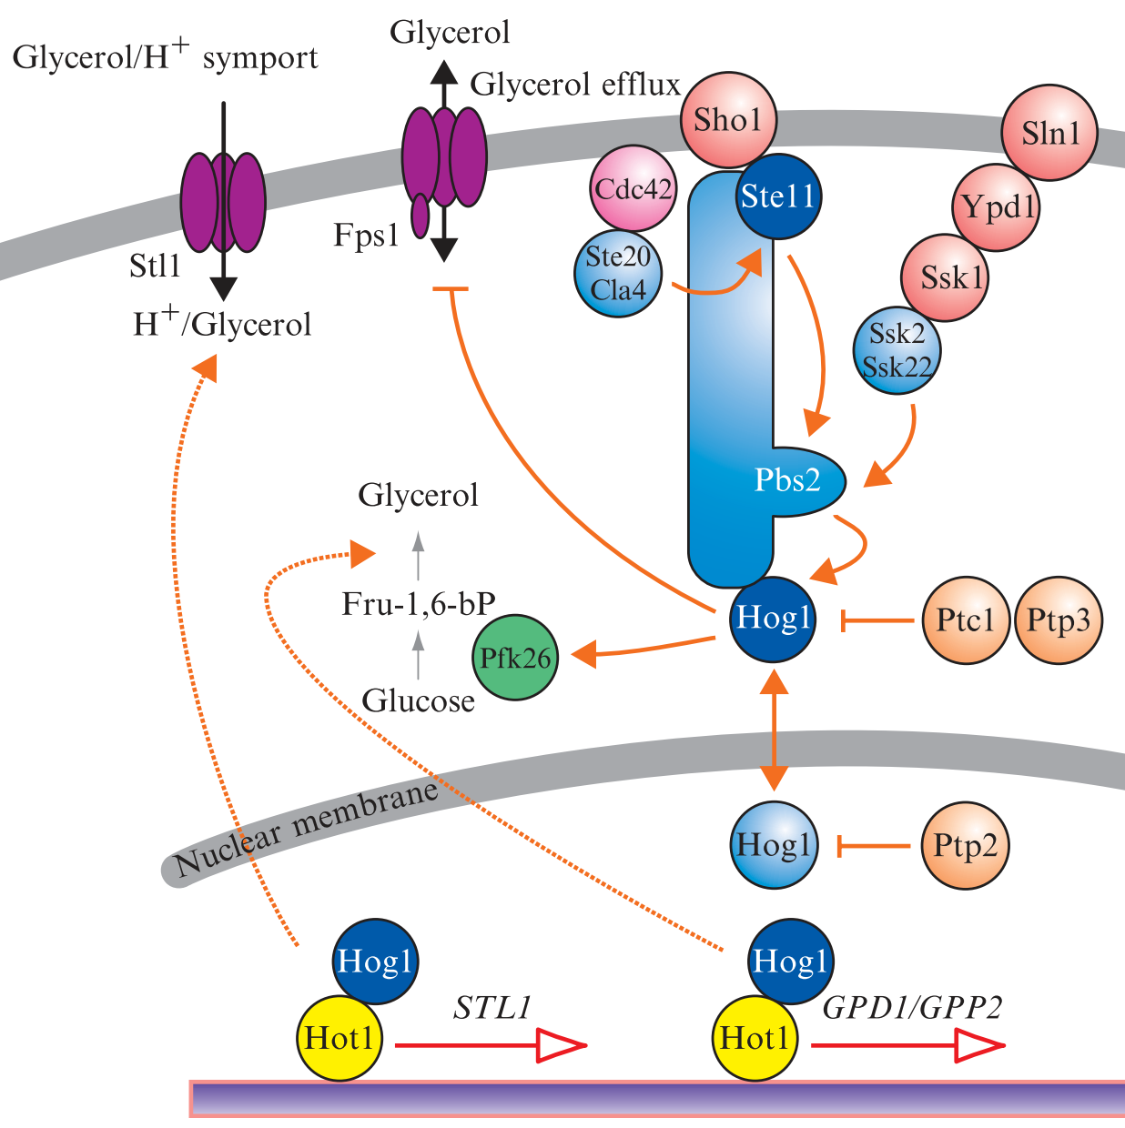
Model system: High Osmolarity Glycerol (HOG) MAPK stress signaling in Saccharomyces cerevisiae.
pathway components and interactions
HOG pathway adaptation processes
Gpp1/2
Gpd1/2
Saito, Genetics, 2012
Tatebayashi and Saito, Nat Commun, 2015
Tatebayashi and Saito, EMBO J, 2020
Hohmann, Methods Enzymol, 2007
Lee and Levin, Genes Develop, 2013

Slide 21
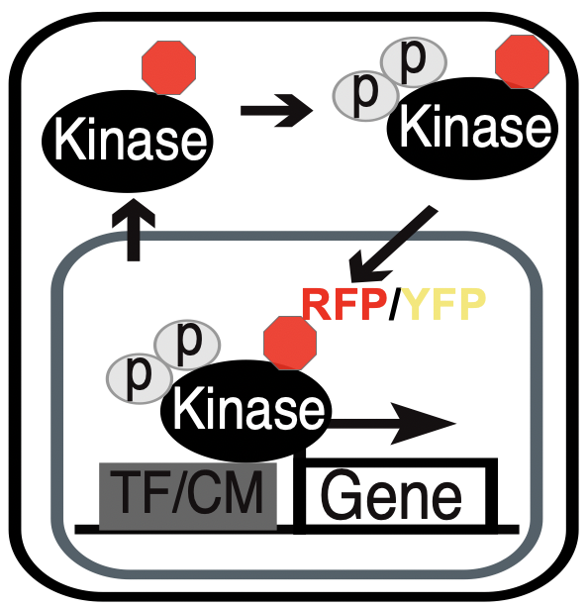
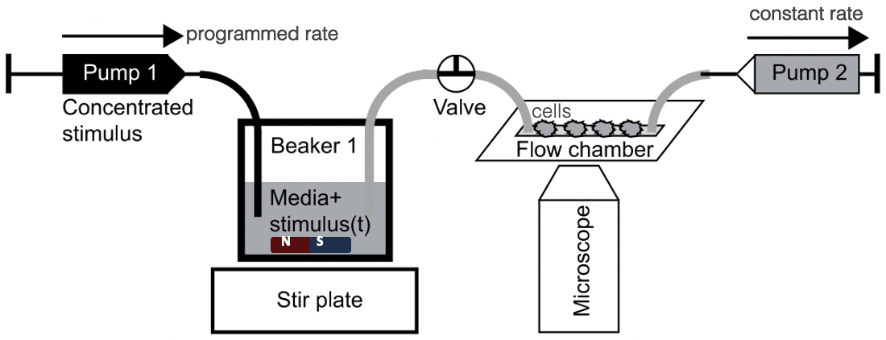
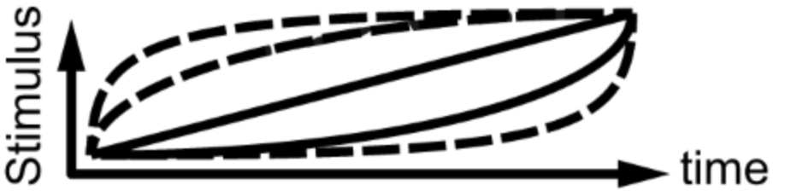
Experiment
High Osmolarity Glycerol (HOG)
signaling pathway
Thiemicke/Jashnsaz, Scientific Reports, 2019
Johnson, PNAS, 2020
Jashnsaz, STAR Protocols, 2021
Stimulus
Time
Stir plate

Slide 23
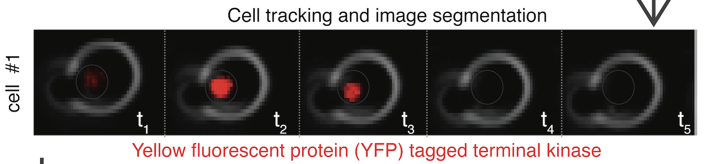
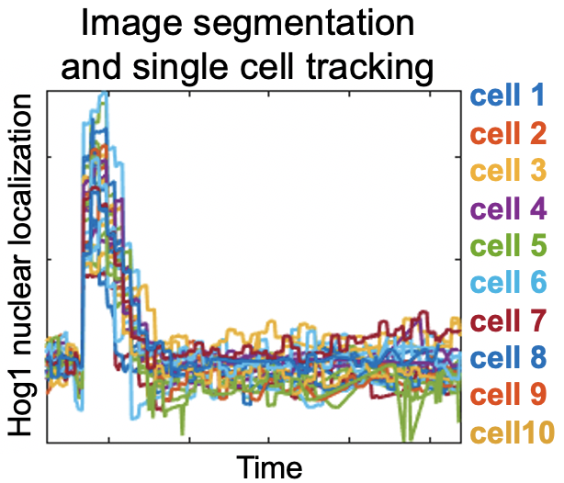
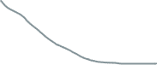

Experiment
High Osmolarity Glycerol (HOG)
signaling pathway
Thiemicke/Jashnsaz, Scientific Reports, 2019
Johnson, PNAS, 2020
Jashnsaz, STAR Protocols, 2021
Stimulus
Time
Stir plate
homogeneous single-cell signaling activation
Hog1 nuclear localization
Time

Slide 24
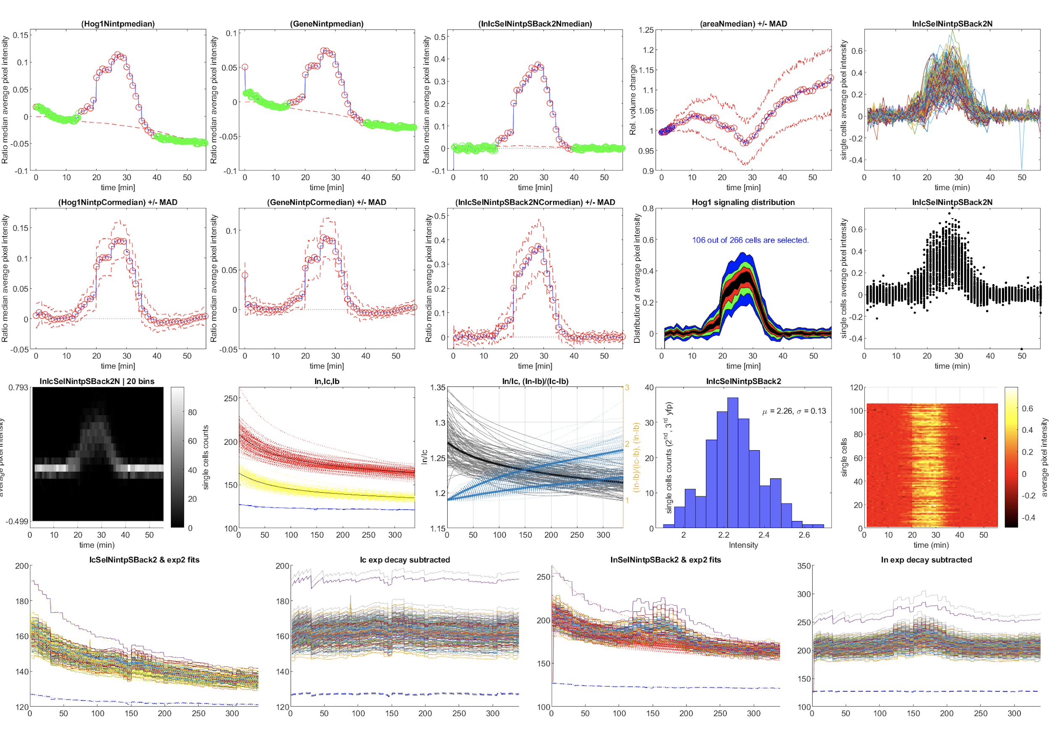

Slide 25
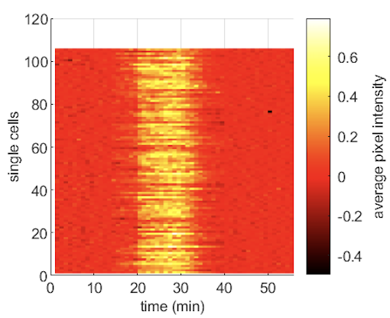
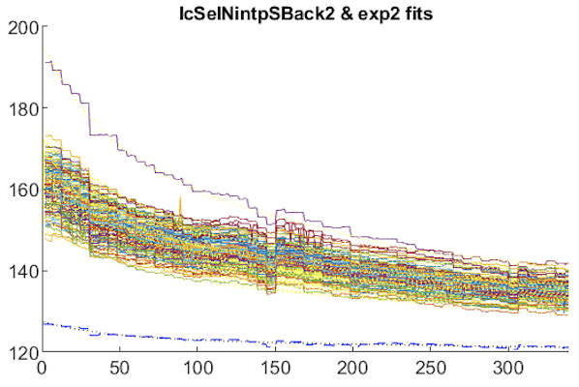
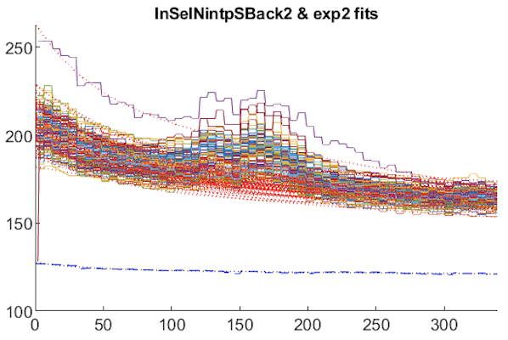
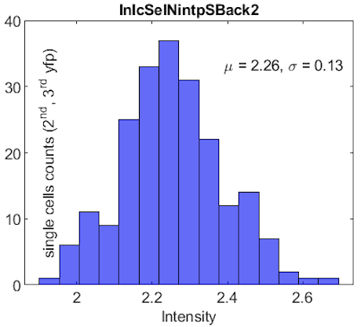
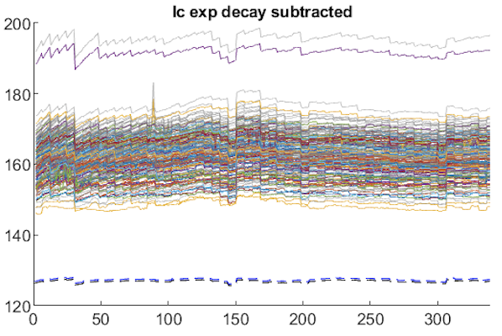



Image segmentation, cell selection, photo-bleach and background correction, normalizations
Ratio (nuc/total)
Total cell Hog1 signal dynamic
Nuclear Hog1 signal dynamic

Slide 26

Hog1 nuclear localization
$$Hog1^{nuc}\left(t\right)= \frac{\frac{I_{n}\left(0\right)}{I_{n}\left(t\right)}{∗I}_{N}\left(t\right) −{ \frac{I_{b}(0)}{I_{b}(t)}∗I}_{B}\left(t\right) }{\frac{I_{t}\left(0\right)}{I_{t}\left(t\right)}∗I_{T}\left(t\right) − {\frac{I_{b}(0)}{I_{b}(t)}∗I}_{B}\left(t\right)} −O\left(0\right)$$
$I_{N}\left(t\right)$, nuclear Hog1 signal dynamic
$I_{T}\left(t\right)$, total cell Hog1 signal dynamic
$I_{B}\left(t\right)$, background signal
$\frac{I_{n}\left(0\right)}{I_{n}\left(t\right)}$, nuclear cell Hog1 signal exponential decay factor
$\frac{I_{t}\left(0\right)}{I_{t}\left(t\right)}$, total cell Hog1 signal exponential decay factor
$\frac{I_{b}\left(0\right)}{I_{b}\left(t\right)}$, background exponential decay factor

Slide 27

Temporal stimulations of single cells result in differential dynamic responses and phenotypes.
Each condition is from multiple BRs and each BR is from 100+ of single cells.
High Osmolarity Glycerol (HOG) MAPK stress signaling in Saccharomyces cerevisiae.
Jashnsaz et al, ﻿in preparation
Unpublished results

Slide 28

Integrate the HOG data with computational modeling to infer HOG models parameters to make testable predictions.
Jashnsaz et al., iScience, 2020
Jashnsaz et al., STAR Protocols, 2021

Slide 29
Using dynamic signaling responses measured under temporal cell
stimulations improve model predictions under new conditions:
New temporal stimuli inputs
mutant perturbing feedback regulation
mutants on phosphatase varying expression levels
Jashnsaz et al., iScience, 2020
Jashnsaz et al., STAR Protocols, 2021

Slide 30
Outline
Tuesday, April 4, 2023
Big Biological Data
Dynamic Cellular Response
Thursday, April 6, 2023
Machine Learning and Model Parameter Inference
Jupyter notebook

Slide 31


Infer models parameters using signaling measurements.

Slide 32



Validate the models' predictions under new perturbations.

Slide 34




Parametrize the HOG models using the Hog1 nuclear localization data.
Experiment linear 0.4M
10 predictions
Hog1 nuclear
localization
Jashnsaz et al., iScience, 2020
Jashnsaz et al., STAR Protocols, 2021

Slide 35

Simulate signaling data under different time-varying cell stimulations.
Time (min)

Slide 36
Different time-varying cell stimulations result in distinct signaling dynamic responses.

Slide 37

Temporal stimulations improve model prediction.
steps traindata
diverse traindata
Jashnsaz et al., iScience, 2020
Jashnsaz et al., STAR Protocols, 2021

Slide 38


Temporal stimulations to study mutants’ effects.
c
c
c
c
c
c
Predictions from
WT model trained with
temporal stimulation
Activation
Activation
PREDICTIONS
DATA
Jashnsaz et al., iScience, 2020
Jashnsaz et al., STAR Protocols, 2021

Slide 39



Ptp2 phosphatase regulate Hog1 rate threshold.
Guoliang Lee, PhD
Amanda Johnson, PhD
slow rate osmolarity increase
Ptp2 regulate Hog1 rate threshold
None
Wild type level
Over-expressed
Over-expressed higher
No Hog1^{nuc} response
Johnson, PNAS, 2021

Slide 40



Temporal stimulations to study mutants’ effects.
Phosphatase varying expression levels
Activation
UE 0.50
WT 1.00
OE 2.00
Predictions from
WT model trained with
temporal stimulation
Activation
UE data
Predictions
OE data
Predictions
Jashnsaz et al., iScience, 2020
Jashnsaz et al., STAR Protocols, 2021

Slide 41
Acknowledgement
Collaborators:
Zachary R Fox, PhD
Los Alamos National Laboratory
Brian E Munsky, PhD
Colorado State University
Postdoctoral Committee:
Roger J Colbran, PhD
Owen P McGuinness, PhD
David G Harrison, MD
Ege T Kavalali, PhD
Todd R Graham, PhD
Vanderbilt University
Neuert Lab
John Adams
Abraheem Khouqeer
Blythe Hospelhorn
Jason Hughes
Ben Kesler
Gregor Neuert
Previous members
Rama Ali
Alex Thiemicke
Amanda Johnson
Rohit Venkat
Evan Wang
Guoliang Li
Advanced Computing Center for Research & Education
ACCRE Vanderbilt

Slide 42









Fisher Information Matrix analysis to estimate expected model parameters uncertainty.
The amount of information,
, Observable x, parameter $Λ$
Nodes dynamics
stimulation input
model parameters
Zachary Fox, PhD
The Pasteur Institute
Brian Munsky, PhD
Colorado State University
parameter j
parameter i
Fox, Zachary R, PLoS Comput Biol, 2019
Notes:
The FIM provides the amount of information an observable could provide around an unknown parameter, and it has been
extensively used to estimate how well potential experiments will constrain model parameters.

Slide 43

Temporal stimuli implementation
in experiments

Slide 44


